Slide 1
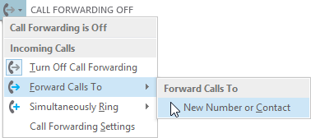
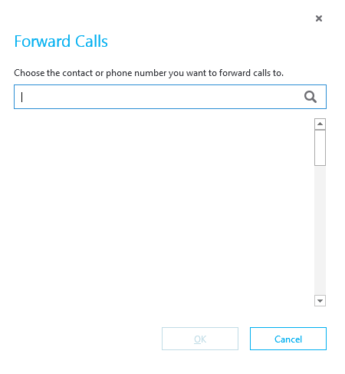




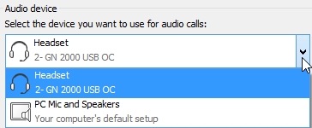



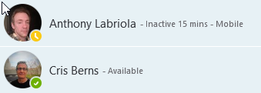


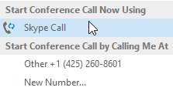
Forward your phone calls*
Skype for Business (Lync)
Quick Start Guide
Audio setup and making calls
In the lower-left of the main Skype for Business window, click the Call Forwarding button.
Select Forward Calls To.
Select New Number or Contact. Choose a contact, or type a number in the Forward Calls field.
Audio calling
1
Set up your audio device
First things first: set up your audio device and check the quality. You can use your computer’s mic and speakers, plug in a headset.
2
3
Click Select Your Primary Device in the lower-left corner of the main Skype for Business window.
Click Audio Device Settings.
Pick your device from the Audio Device menu, and adjust the speaker and mic volume.
1
Turn off call forwarding
Sara Nyberg – Available – Video Capable Account Executive
Aaron Buxton – Available – Video Capable Lab Specialist
2
Adam Jarman – Available – Video Capable Engineer II
(425) 555-1212
Arianne LaBatelier – Available – Video Capable Technical Analyst II
3
*Call forwarding features are available on a limited basis.
Start a call
1
2
Hover on a contact’s pic until the quick menu appears.
Click the Phone button.
Start a conference call
1
In your Contacts list, select multiple contacts by holding the Ctrl key, and clicking the names.
Right-click any of the selected names, then click Start a Conference Call.
Click Skype Call.
2
3
© 2015 Microsoft Corporation. All rights reserved.

Slide 2

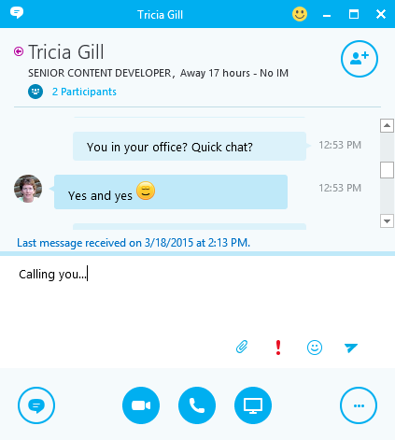

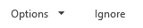

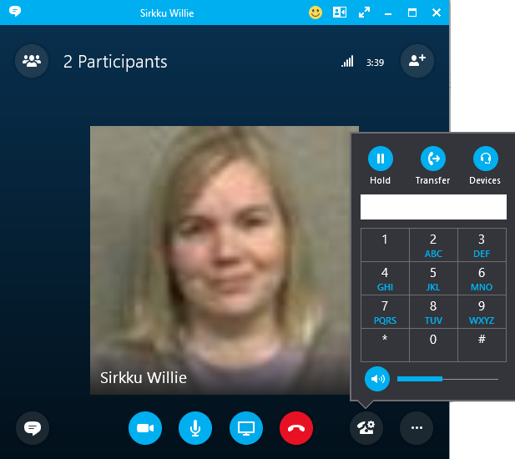
Answer a call
When someone calls you, an alert pops up in the lower-right of your screen.
To answer the call, click anywhere on the photo area.
To reject the call, click Ignore.
To start an instant messaging (IM) conversation with the caller instead of an audio call, click Options, and then Reply by IM.
To reject the call and other calls, until you change your status click Options, and then Set to Do not Disturb.
Add audio to an IM
In the conversation window, click the Phone button.
Sara Nyberg ACCOUNT EXECUTIVE, Available – Video Capable
Sara Nyberg
Account Executive
Invite more people to a call
In the Meeting pane, click or, in the Participants pane, click
Select or multi-select (Ctrl-click) from your contacts, or type someone’s name or phone number in the Search field, then select them from the results. Click OK.
Your new invitees receive a request to join your call.
Use audio call controls
During a call, point to the buttons to do the following:
To put the call on hold, click the Hold button.
To mute your audio, click the Mic button in the conversation window.
If call transferring is available for your account, click the Transfer button, and select the number you want.
To hang up, click the Phone button in the conversation window.
Check your voice mail
Click the Phone tab. You’ll see your messages and the caller’s info.
Pause on a voice mail message and click Play.
Click More Options, and select one of the choices, such as:
Open Item in Outlook provides more information about the call.
Delete Item deletes the voice mail from Lync.
Start a Video Call with the contact.
Mark item as Read
Call the contact.
See Contact Card
You can also click View more in Outlook to open the Voice Mail folder for more info.
Sara Nyberg
v. 4.27.15

